Slide 1
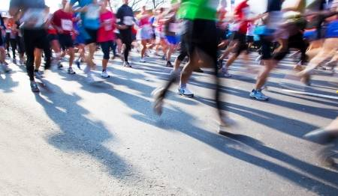
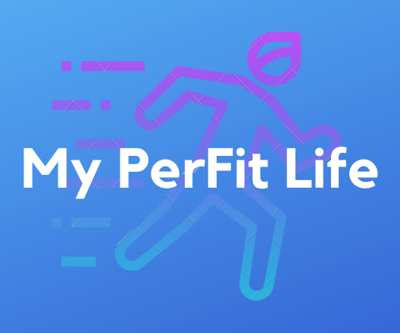
My PerFit Life
Dan Citardi, Payal Narkhede, Ankit Singh, Erin Stansbury

Slide 2
70%
Roughly the percentage of overweight or obese citizens in America.
Notes:
CBS - November 2018
Erin

Slide 3
330%
The percentage by which the health and fitness app category usage grew within the App Store since 2014.
Notes:
Flurry Analytics 2017
Erin

Slide 4
About
By these statistics, there is very clearly a need for a mobile application that will not only track users’ activity, but motivate them towards a life of fitness.
Notes:
Erin

Slide 5

About:
My PerFit Life
A practical, convenient, and easy-to-use tool for users to track their running or walking distance
Users have a simple view of their distance accomplishments as well as their calorie burn count
Notes:
Erin

Slide 6
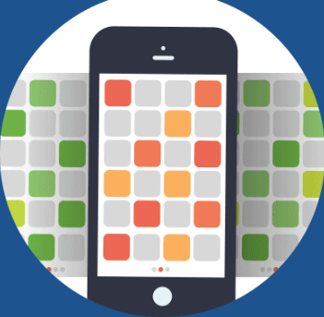
Simplistic Design
While we have several different personas of users ranging from different backgrounds and ages, one key group we focused on while designing was millennials.
Millennials are known to download more apps than any other age group, with an average of 3 screens of mobile apps.
Notes:
https://mindsea.com/millennials-app-research/
Erin

Slide 7
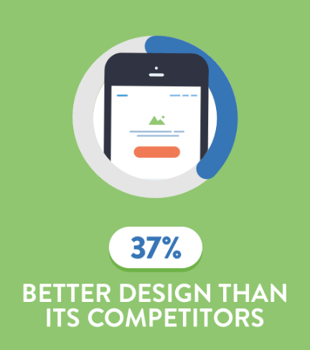
Simplistic Design
A group of millennials were asked in a survey which attributes are the most important to them regarding mobile applications.
37% responded saying that better design would influence their decision when downloading a mobile app.
The team kept this statistic in mind when designing My PerFit Life in order to create an easy and decluttered app.
Notes:
https://mindsea.com/millennials-app-research/
Erin

Slide 8
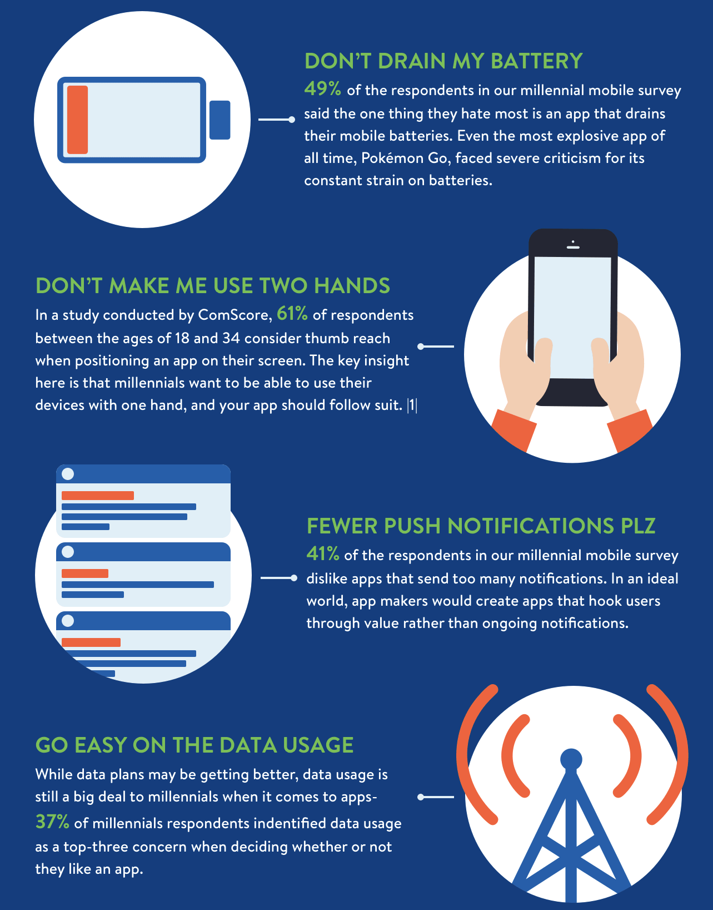
Key Attributes for an Ideal Mobile App
The survey delved even deeper into other features that mobile app users find ideal.
After reviewing these results, the My PerFit Life team took these into consideration when designing the simplistic, fitness app.
Notes:
Erin

Slide 9

Potential Users and Clientele
Fitness experts: individuals that are concerned with daily lifestyle and want to keep track of fitness and calorie intake/calories burned
Fitness novices: those who are just beginning their road to a healthier lifestyle and want a simple app to do so
Fitness coaches: able to track the progress of trainees
Notes:
Dan

Slide 10
Functional Requirements
Framework should give the enrollment page.
Framework should be able to create the profile for new user.
System should not register the same user again.
User should be able to edit or delete their workouts/goals.
The system should be able to keep the database of user.
Framework will gather information remotely and store it locally in the cell phone.
Framework shall synchronize the information with a database.
System should be able to show the progress page
System should be able to calculate average calorie burned at the end of the day
User should be able to deactivate or delete the account.
Notes:
Ankit

Slide 11
Non-functional Requirements
Only administrator should be allowed to access/modify user’s data.
Minimum maintenance of 10 hrs per week.
Multiple users: 10,000 users at the same time.
Group competition: 20 people per group.
Response time: Not more than 2 seconds.
Reliability: More than 98%.
Maintainability: Easy to modify and convenient for code upgrades.
Availability: More than 98%.
Security: Data should be kept confidential by encryption or hashing.
Portability: Portable with android devices.
Notes:
Ankit

Slide 12
Features Version 1.0
Step Counter
Calorie Counter
Total Distance Covered
Add workout distance covered
Register and log into account
Database functionality with username and password
Notes:
Payal

Slide 13
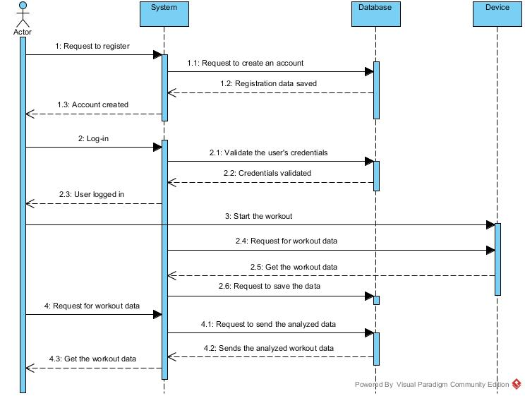
Sequence Diagram
Notes:
Payal

Slide 14
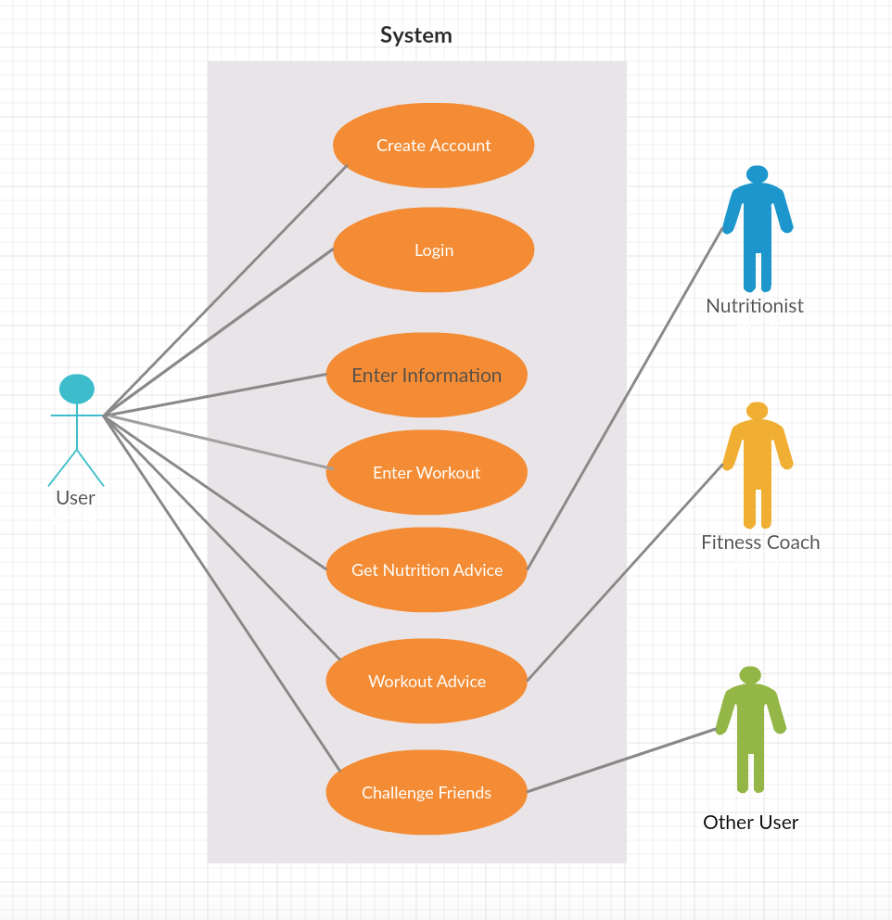
Notes:
Dan

Slide 15
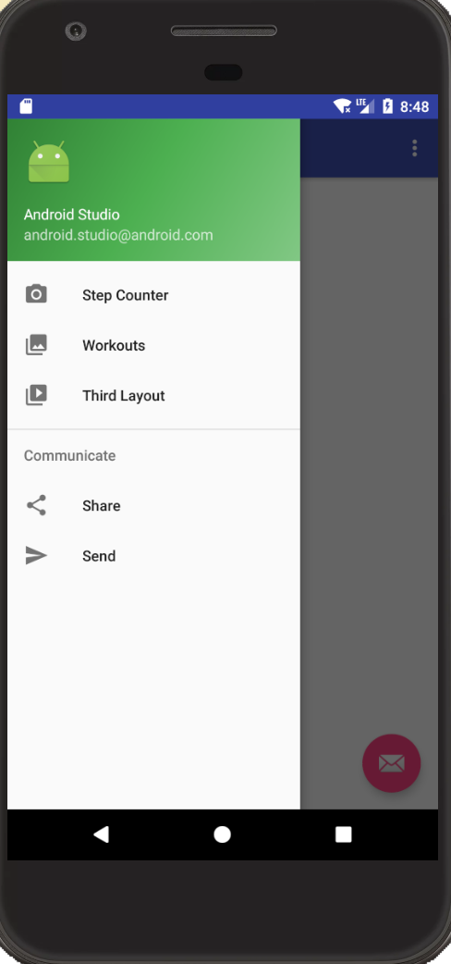
Design Decisions
Navigation menu
Everything accessible through this navigation drawer
Ability to easily add more screens and features to app
Notes:
Dan

Slide 16

Design Decisions: Google Firebase
Email Verification Authentication
Real-time Database
Data == JSON Format
Firebase API for Android Studio
Notes:
Dan

Slide 17
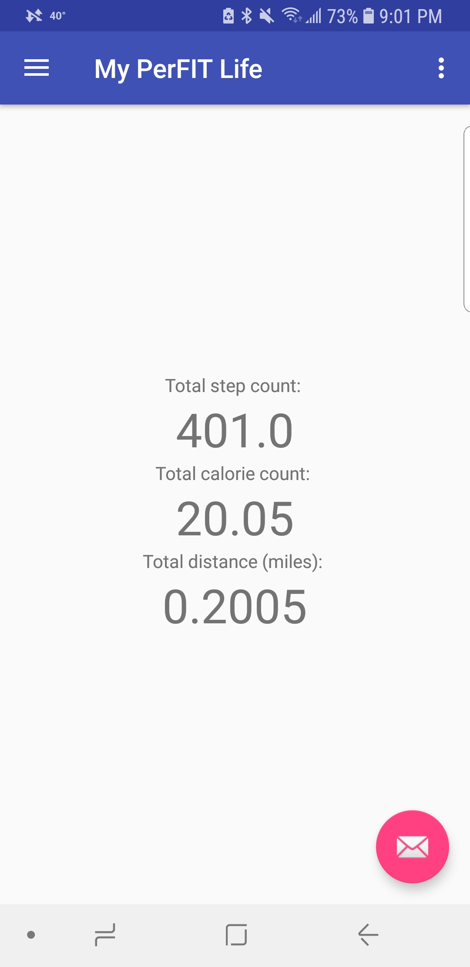
Design Decisions cont’d
Main functions all available on one page for easy access and reading
Basic formula to calculate calorie count and distance
To be updated related to each individual in future version
Notes:
Dan

Slide 18
My PerFit Life Demo
Notes:
Dan

Slide 19
Release Plan: My PerFit Life 2.0
Incorporate GPS into workouts to more effectively track distance covered
Customize goals for each user
More detail tracked with each workout
Notes:
Payal

Slide 20
Release Plan: My PerFit Life 3.0
Keep track of calories eaten by adding foods
Connect users with a fitness coach in the area
Create custom workout plans for each user based on goals and experience
Notes:
Payal

Slide 21

Questions?
Notes:
Dan

